Slide 1
Automation Status – Disney+ WEB
Updated as of September 2025

Slide 2
Agenda
Introduction to App-Ex
Overview
Automation Coverage​​
Automation Flow
Release Management
Resources

Slide 3
Introduction to App-Ex
What is App-Ex?​
App Experience team – owning the entire web user experience, with a strong focus on the Player​
Responsibilities
Bug fixes, enhancements​
Pipeline execution​
Support for all player-related issues​
Tools
Java Selenium, POM Framework, TestNG​

Slide 4
Overview
14
553
~90%
Pipelines (Different Locales)
Automated Tests
Pipelines Stability

Slide 5
D+ Web Automation Coverage
Product​ | Automated​ | Automation Stability %​ ​
Disney+ Web​ | 553 | ~90%​
Product​ | Backlog​
Disney+ Web​ | 203
Region​ | Total test case​ | Passed​ | ~ Duration​ | Pass %​
US Smoke | 144​ | 132 | 35m | 92%​
US Live | 17​ | 6​ | 17m | 35%​
US Player | 61​ | 45​ | 1h​ | 74%​
US App-Ex | 261​ | 239​ | 45m | 92%​
AR | 33 | 19 | 21m | 76%
CA | 23 | 23 | 14m | 100%
GB | 9 | 8 | 14m | 82%
Region​ | Total test case​ | Passed​ | ~ Duration​ | Pass %​
MX | 68​ | 55 | 25m | 81%​
BR | 8​ | 7 | 14m | 88%​
SE | 9 | 9 | 11m | 100%​
FR | 4​ | 4 | 12m | 100%​
AU | 36​ | 30 | 25m | 83%​
NZ | 34​ | 29 | 30m | 85%​
SG | 5​ | 5 | 5m | 100%​

Slide 6






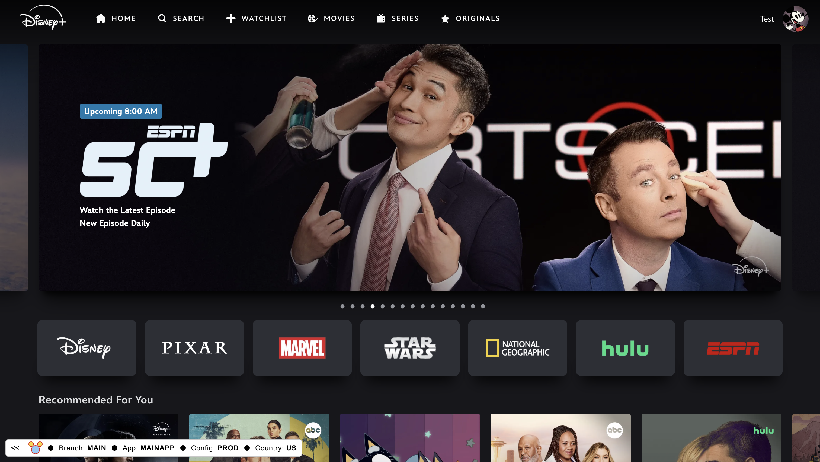
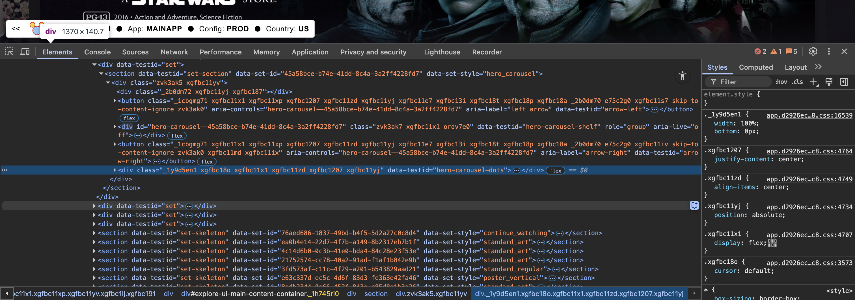
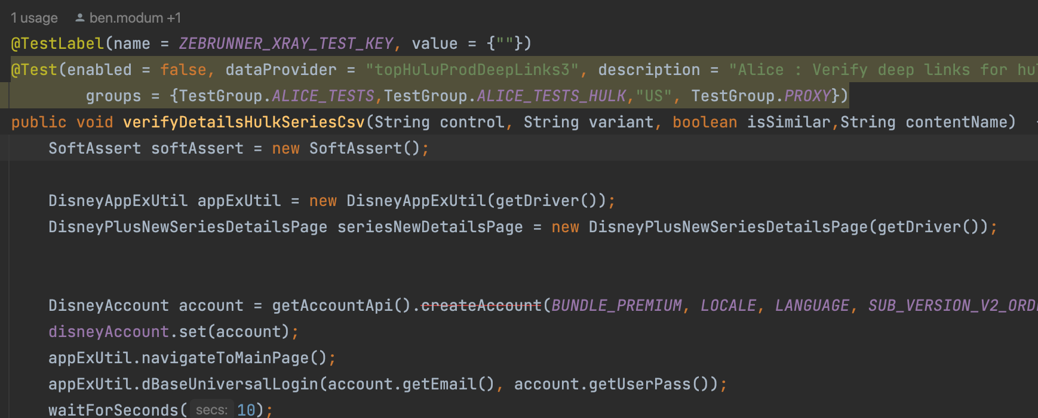





Automation Flow
https://zebrunner.qateam.bamgrid.com/projects/DIS/automation-launches
https://reportportal.productivity.dtci.technology/ui/ - web-automation/launches/all
https://github.bamtech.co/qait/web-automation.git

Slide 7
Release Management
RELEASE SCHEDULE:
Releases are every Thursday and Monday.
The code is cut on Wednesday and Friday around 3:00 pm ET.
Validation:
24-hour window to validate
Check impact on existing tests
Post-validation
Share results in channel
Sign-off for release

Slide 8
Resource
On-call: https://confluence.disney.com/spaces/QAspace/pages/1421615958/On-call+Automation+Process+D+S
Stage-web URL: https://stage-web.disneyplus.com/
Jira Board: https://jira.disney.com/secure/RapidBoard.jspa?rapidView=12313&view=detail#
Jenkins: https://automation.qateam.bamgrid.com/jenkins/job/web-automation

Slide 9
Thank You

